Slide 1
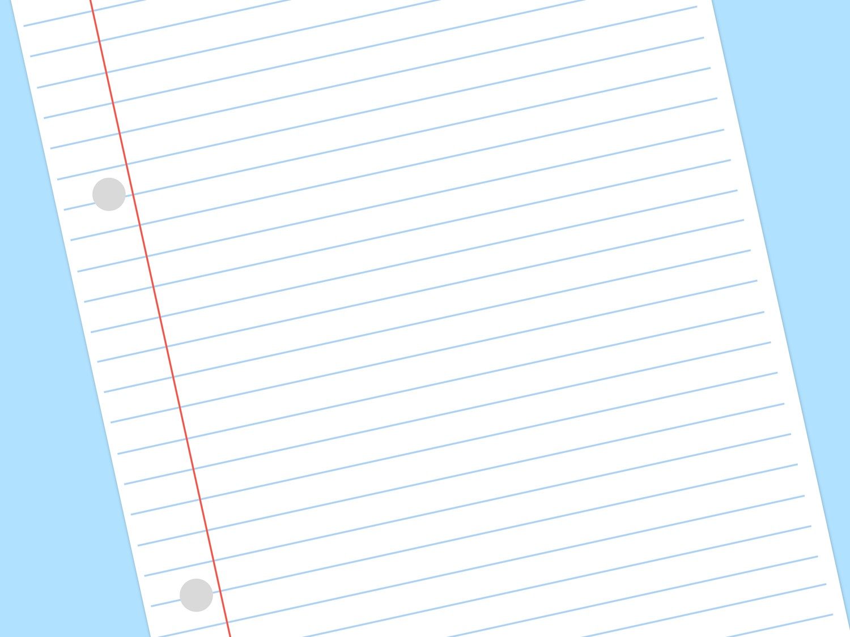



Forming Letters
An interactive cursive writing activity

Slide 2


Just click on the pencil and it will show you how to form the letter.
Press the back button at any time during the slide show to return to the letter choice screen.

Slide 3




























Click on the letter you would like to practise.

Slide 4



Watch the pencil.
MENU
Click on the pencil to see it write.

Slide 5


Watch the pencil.
MENU
Click on the pencil to see it write.

Slide 6
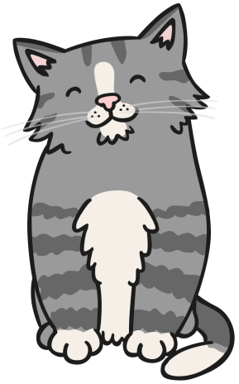

Watch the pencil.
MENU
Click on the pencil to see it write.

Slide 7


Watch the pencil.
MENU
Click on the pencil to see it write.

Slide 8


Watch the pencil.
MENU
Click on the pencil to see it write.

Slide 9



Watch the pencil.
MENU
Click on the pencil to see it write.

Slide 10



Watch the pencil.
MENU
Click on the pencil to see it write.

Slide 11


Watch the pencil.
MENU
Click on the pencil to see it write.

Slide 12


Watch the pencil.
MENU
Click on the pencil to see it write.

Slide 13


Watch the pencil.
MENU
Click on the pencil to see it write.

Slide 14


Watch the pencil.
MENU
Click on the pencil to see it write.

Slide 15


Watch the pencil.
MENU
Click on the pencil to see it write.

Slide 16
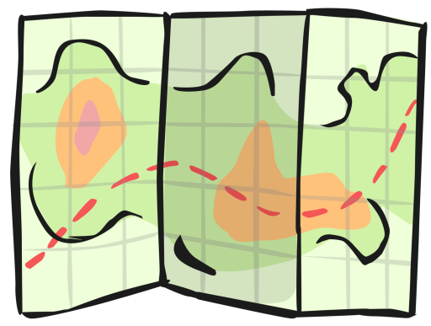

Watch the pencil.
MENU
Click on the pencil to see it write.

Slide 17
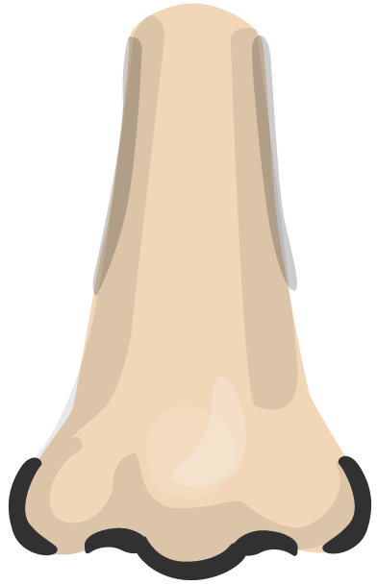

Watch the pencil.
MENU
Click on the pencil to see it write.

Slide 18


Watch the pencil.
MENU
Click on the pencil to see it write.

Slide 19


Watch the pencil.
MENU
Click on the pencil to see it write.

Slide 20


Watch the pencil.
MENU
Click on the pencil to see it write.

Slide 21


Watch the pencil.
MENU
Click on the pencil to see it write.

Slide 22


Watch the pencil.
MENU
Click on the pencil to see it write.

Slide 23


Watch the pencil.
MENU
Click on the pencil to see it write.

Slide 24


Watch the pencil.
MENU
Click on the pencil to see it write.

Slide 25


Watch the pencil.
MENU
Click on the pencil to see it write.

Slide 26


Watch the pencil.
MENU
Click on the pencil to see it write.

Slide 27


Watch the pencil.
MENU
Click on the pencil to see it write.

Slide 28
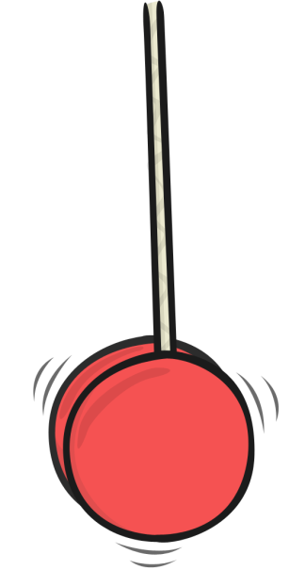

Watch the pencil.
MENU
Click on the pencil to see it write.

Slide 29


Watch the pencil.
MENU
Click on the pencil to see it write.

Slide 30

Forming Letters
Copyright © 2012 twinkl
www.twinkl.co.uk

