Slide 1
Forming Letters
An interactive cursive writing activity

Slide 2
Just click on the pencil and it will show you how to form the letter.
Press the back button at any time during the slide show to return to the letter choice screen.

Slide 3
Click on the letter you would like to practise.

Slide 4
Watch the pencil.
MENU
Click on the pencil to see it write.

Slide 5
Watch the pencil.
MENU
Click on the pencil to see it write.

Slide 6
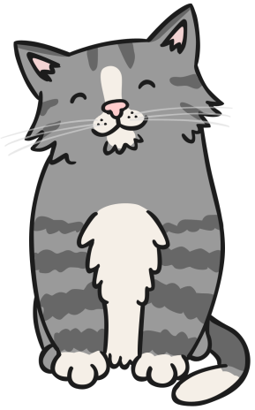
Watch the pencil.
MENU
Click on the pencil to see it write.

Slide 7
Watch the pencil.
MENU
Click on the pencil to see it write.

Slide 8
Watch the pencil.
MENU
Click on the pencil to see it write.

Slide 9
Watch the pencil.
MENU
Click on the pencil to see it write.

Slide 10
Watch the pencil.
MENU
Click on the pencil to see it write.

Slide 11
Watch the pencil.
MENU
Click on the pencil to see it write.

Slide 12
Watch the pencil.
MENU
Click on the pencil to see it write.

Slide 13
Watch the pencil.
MENU
Click on the pencil to see it write.

Slide 14
Watch the pencil.
MENU
Click on the pencil to see it write.

Slide 15
Watch the pencil.
MENU
Click on the pencil to see it write.

Slide 16
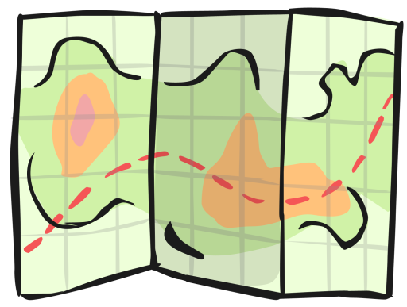
Watch the pencil.
MENU
Click on the pencil to see it write.

Slide 17
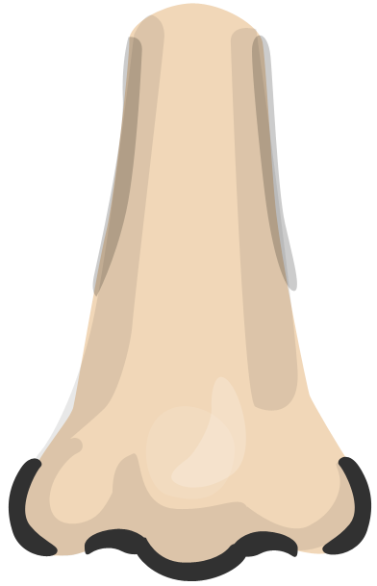
Watch the pencil.
MENU
Click on the pencil to see it write.

Slide 18
Watch the pencil.
MENU
Click on the pencil to see it write.

Slide 19
Watch the pencil.
MENU
Click on the pencil to see it write.

Slide 20
Watch the pencil.
MENU
Click on the pencil to see it write.

Slide 21
Watch the pencil.
MENU
Click on the pencil to see it write.

Slide 22
Watch the pencil.
MENU
Click on the pencil to see it write.

Slide 23
Watch the pencil.
MENU
Click on the pencil to see it write.

Slide 24
Watch the pencil.
MENU
Click on the pencil to see it write.

Slide 25
Watch the pencil.
MENU
Click on the pencil to see it write.

Slide 26
Watch the pencil.
MENU
Click on the pencil to see it write.

Slide 27
Watch the pencil.
MENU
Click on the pencil to see it write.

Slide 28
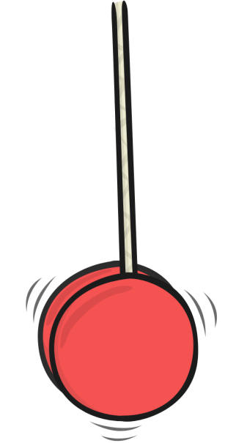
Watch the pencil.
MENU
Click on the pencil to see it write.

Slide 29
Watch the pencil.
MENU
Click on the pencil to see it write.

Slide 30
Forming Letters
Copyright © 2012 twinkl
www.twinkl.co.uk

