Slide 1
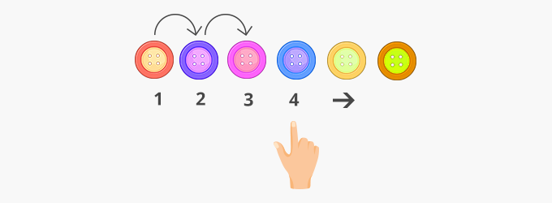
Counting
1mm then to cms

Slide 2
Year 4 – Autumn Block 4 – Multiplication and Division
Step 1: Multiply by 10
© Classroom Secrets Limited 2018

Slide 3
Generalisation
What do we do when we multiply by 10? What happens?

Slide 4
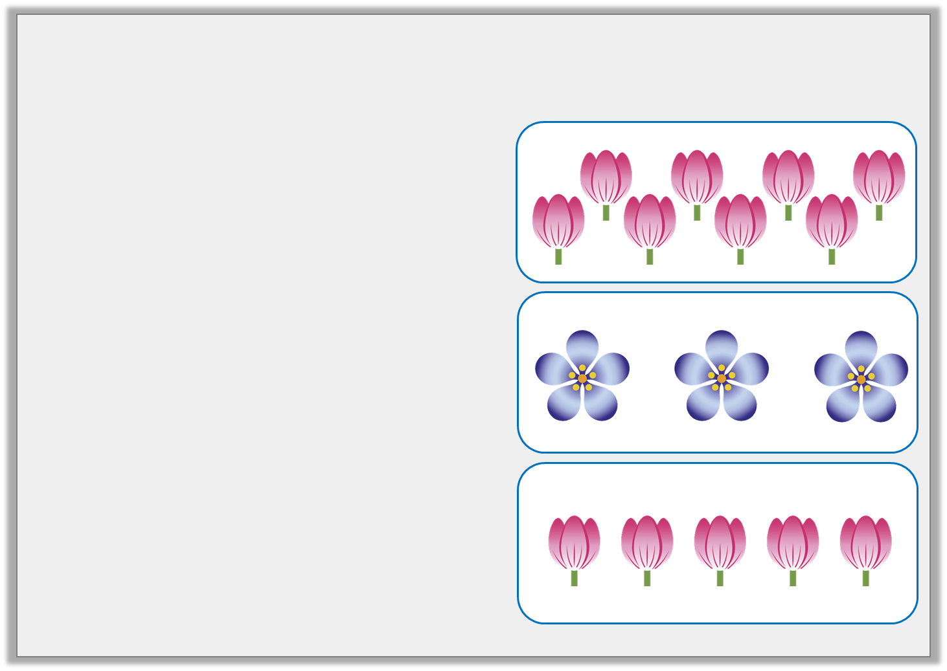
Introduction
Match the statements to the correct image.
3 lots of 5
5 lots of 3
8 lots of 3
© Classroom Secrets Limited 2018

Slide 5
Introduction
Match the statements to the correct image.
3 lots of 5
5 lots of 3
8 lots of 3
© Classroom Secrets Limited 2018

Slide 6
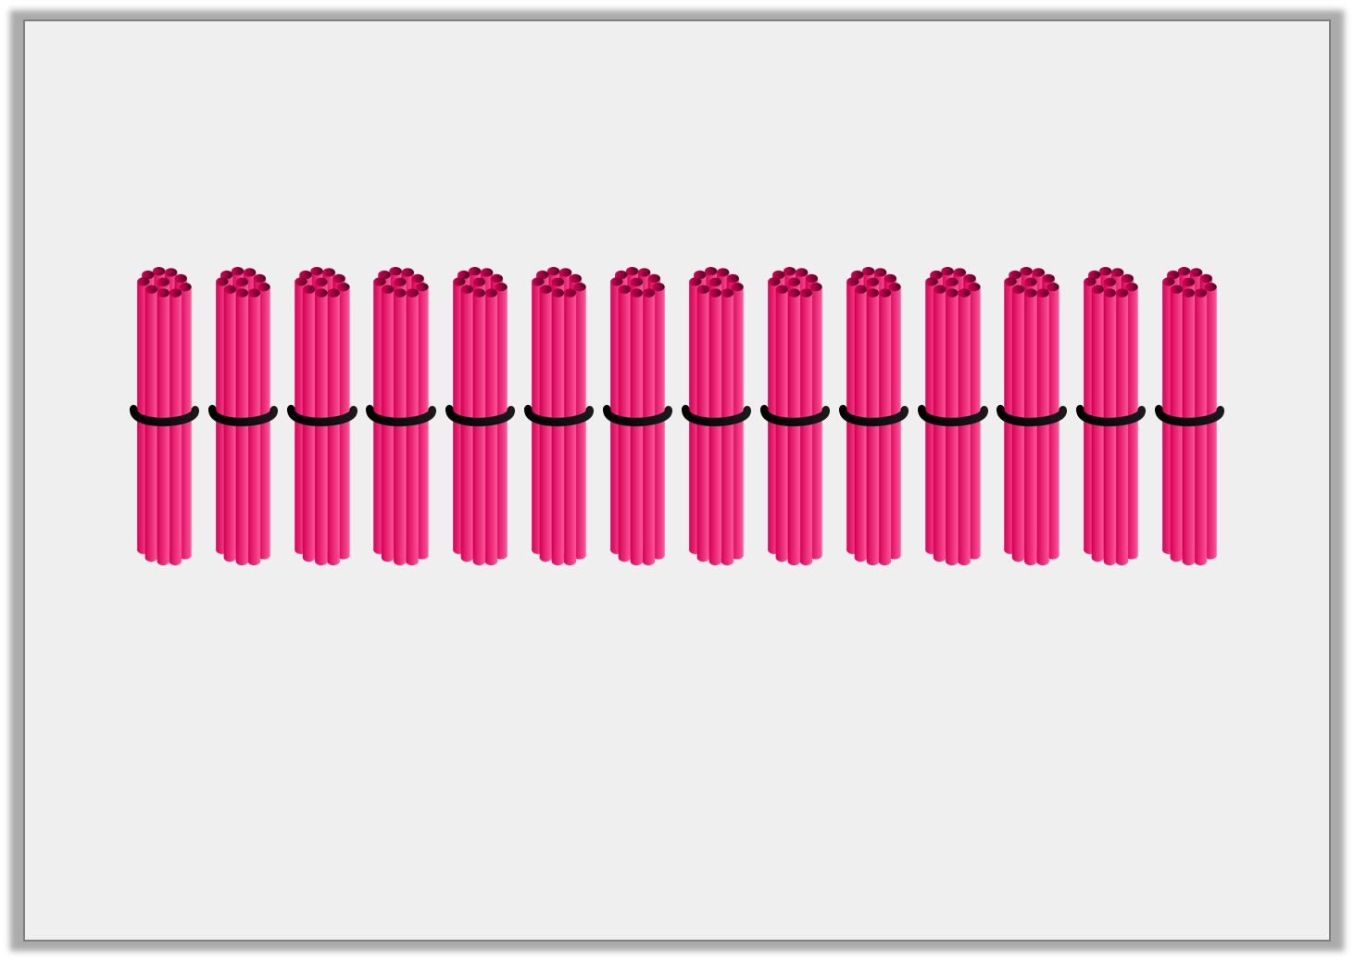
Varied Fluency 1
Complete the calculation represented by the image below.
 | x |  | =
© Classroom Secrets Limited 2018

Slide 7
Varied Fluency 1
Complete the calculation represented by the image below.
14 | x | 10 | = | 140
© Classroom Secrets Limited 2018

Slide 8
Varied Fluency 2
True or false?
10 lots of 76 crayons gives a total of 760 crayons.
© Classroom Secrets Limited 2018

Slide 9
Varied Fluency 2
True or false?
10 lots of 76 crayons gives a total of 760 crayons.
True
© Classroom Secrets Limited 2018

Slide 10
Varied Fluency 3
Eggs are sold in boxes of 10.
Mark buys 27 boxes of eggs.
How many eggs does he buy altogether?
© Classroom Secrets Limited 2018

Slide 11
Varied Fluency 3
Eggs are sold in boxes of 10.
Mark buys 27 boxes of eggs.
How many eggs does he buy altogether?
270 eggs
© Classroom Secrets Limited 2018

Slide 12
Varied Fluency 4
Which representation is the odd one out?
A.
B.
Tens | Ones
10
10
10
10
10
10
C.
6 | 6 | 6 | 6 | 6 | 6 | 6 | 6 | 6 | 6
© Classroom Secrets Limited 2018

Slide 13
Varied Fluency 4
Which representation is the odd one out?
A.
B.
Tens | Ones
10
10
10
10
10
10
C.
6 | 6 | 6 | 6 | 6 | 6 | 6 | 6 | 6 | 6
© Classroom Secrets Limited 2018

Slide 14
Problem Solving 1
The numbers below are the amount of ice creams sold by three ice cream shops. Use the clues to match the shop to their amount.
Ice Cream World sold 10 times more ice creams than Nick’s Ices.
Nice Ice sold 7 lots of ten ice creams.
Super Ice Creams sold 10 times more than Nice Ice.
700
410
70
41
© Classroom Secrets Limited 2018

Slide 15
Problem Solving 1
The numbers below are the amount of ice creams sold by three ice cream shops. Use the clues to match the shop to their amount.
Ice Cream World sold 10 times more ice creams than Nick’s Ices.
Nice Ice sold 7 lots of ten ice creams.
Super Ice Creams sold 10 times more than Nice Ice.
Ice Cream World = 410; Nick’s Ices = 41; Nice Ice = 70; Super Ice Creams = 700
700
410
70
41
© Classroom Secrets Limited 2018

Slide 16
Reasoning 1
Chris buys a pack of crayons. There are 10 crayons in a pack.
It takes 350 crayons to fill the drawer.
He buys 33 more packs.
Does Chris have enough crayons to fill the drawer?
Explain how you know.
© Classroom Secrets Limited 2018

Slide 17
Reasoning 1
Chris buys a pack of crayons. There are 10 crayons in a pack.
It takes 350 crayons to fill the drawer.
He buys 33 more packs.
Does Chris have enough crayons to fill the drawer?
Explain how you know.
No because…
© Classroom Secrets Limited 2018

Slide 18
Reasoning 1
Chris buys a pack of crayons. There are 10 crayons in a pack.
It takes 350 crayons to fill the drawer.
He buys 33 more packs.
Does Chris have enough crayons to fill the drawer?
Explain how you know.
No, because 34 x 10 = 340. He needs 10 more.
© Classroom Secrets Limited 2018

Slide 19
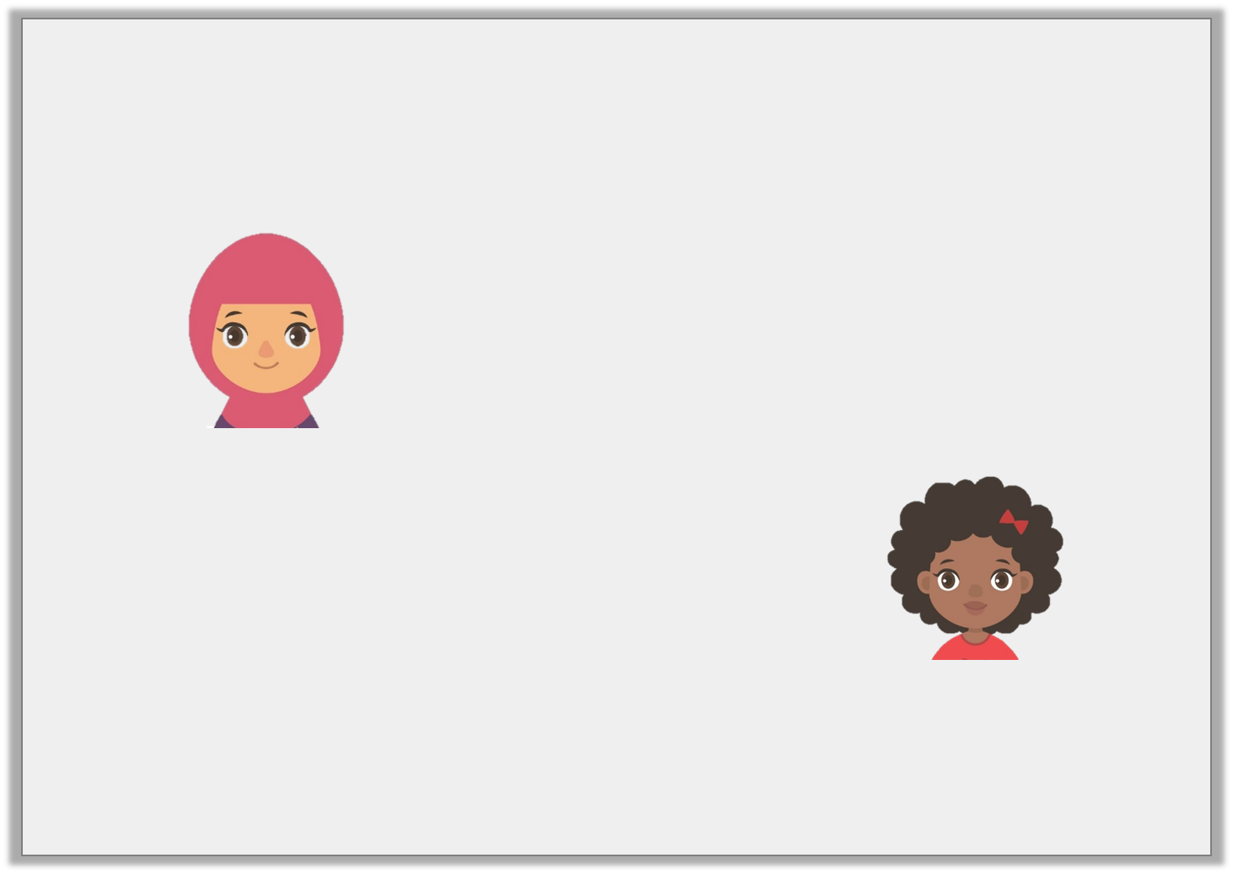
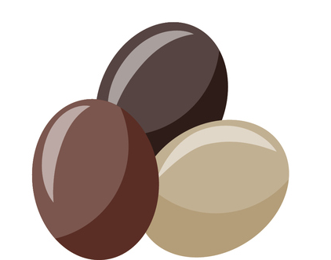
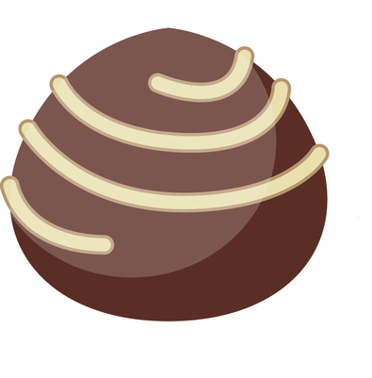
Reasoning 2
Zainab and Kay have bought sweets for a party.
Zainab says,
Kay says,
Who has bought the most? Prove it.
I bought more because I have 10 lots of 45 sweets.
I bought more because I have 45 lots of 10 sweets.
© Classroom Secrets Limited 2018

Slide 20
Reasoning 2
Zainab and Kay have bought sweets for a party.
Zainab says,
Kay says,
Who has bought the most? Prove it.
They both bought the same amount because...
I bought more because I have 10 lots of 45 sweets.
I bought more because I have 45 lots of 10 sweets.
© Classroom Secrets Limited 2018

Slide 21
Reasoning 2
Zainab and Kay have bought sweets for a party.
Zainab says,
Kay says,
Who has bought the most? Prove it.
They both bought the same amount because:
10 x 45 = 450
45 x 10 = 450
I bought more because I have 10 lots of 45 sweets.
I bought more because I have 45 lots of 10 sweets.
© Classroom Secrets Limited 2018

