Slide 1
Creating an information text
11.01.21

Slide 2
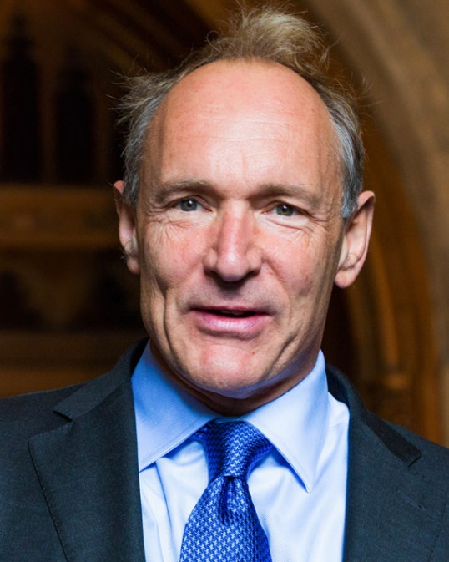
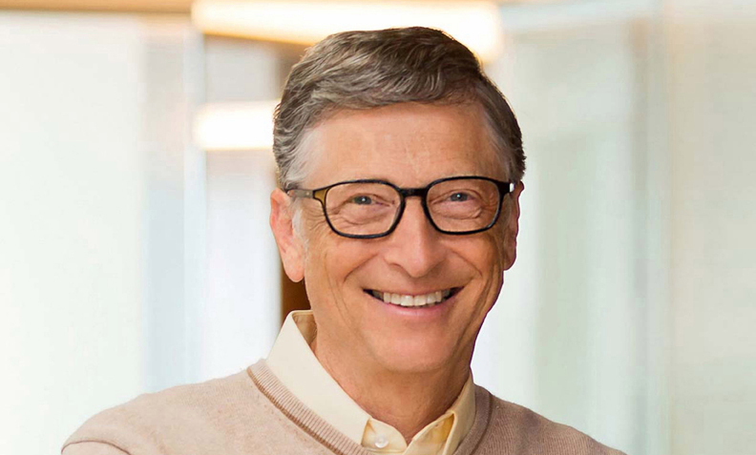
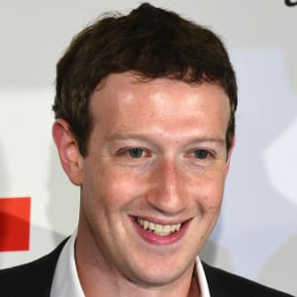
By the end of this unit you will:
Know facts about key figures in computing
Be more confident selecting ambitious vocabulary
Have created your own information text using different Y6 features

Slide 3
Our Writing this week
Audience: The general public
Purpose: Inform people about key figures in computing
Form: Information Text (think back to our information text about the railways)
Style: Formal

Slide 4
Researching
You will need to research and find out facts about several key figures in computing.
Remember when using a search engine it helps to put ks2 in your search to find information pitched at the right level.
Kiddle is a great search engine to use.

Slide 5
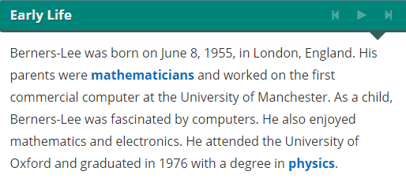
Making Notes
Parents - mathematicians
Born June 8 1955 London
I have found the above paragraph on a website. Look how I take the information but place it into notes. Notes just pick out the key detail and do not use sentences.
Attended Oxford University - physics

Slide 6
Your Task Today
Find out facts and make notes on the following people:
Tim Berners-Lee
Bill Gates
Steve Jobs
You can present your notes as mind maps like the example in the last slide. Each mind map needs at least 8 facts and should have a note about why that person is important in computing.
Suggested Websites:
Tim Berners-Lee - https://kids.kiddle.co/Tim_Berners-Lee or https://kids.britannica.com/kids/article/Tim-Berners-Lee/626687
Bill Gates - https://www.ducksters.com/biography/entrepreneurs/bill_gates.php or https://kids.kiddle.co/Bill_Gates
Steve Jobs - https://www.ducksters.com/biography/entrepreneurs/steve_jobs.php or https://kids.kiddle.co/Steve_Jobs

