Slide 1
Creating an information text
14.01.21

Slide 2
So far this week we have:
Researched key individuals in computing
Generated vocabulary
Wrote an introductory paragraph

Slide 3
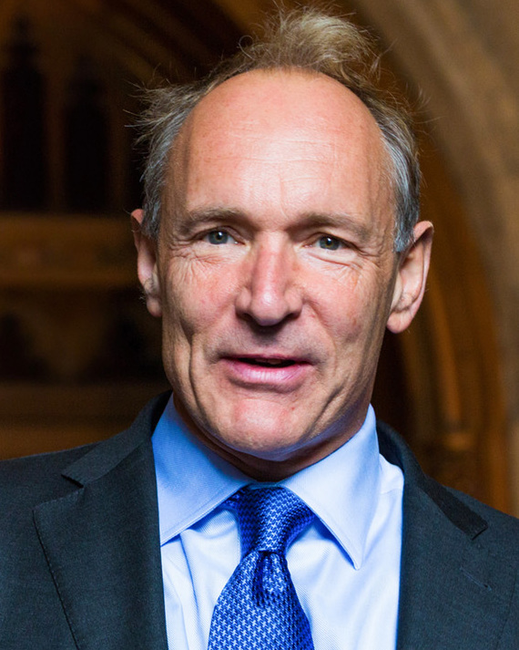
Today we are going to write a paragraph about Tim Berners-Lee
My notes:
Created the WWW in 1991
British computer scientist
Born June 8th 1955 London
Parents – mathematicians
Oxford Uni physics
Worked at CERN (Switzerland)
Knighted Queen Elizabeth 2004

Slide 4
What do I want to include in my paragraph?
Relative Clause
Subordinate Clause
Parenthesis
At least 6 sentences
A question mark or an exclamation mark

Slide 5
Tim Berners-Lee
My notes:
Created the WWW in 1991
British computer scientist
Born June 8th 1955 London
Parents – mathematicians
Oxford Uni physics
Worked at CERN (Switzerland)
Knighted Queen Elizabeth 2004
WWW (world wide web) is an extremely famous letter string but do you know who the brains behind the world wide web is? Tim Beners-Lee is a British computer scientist, who is credited with developing the World Wide Web in the year 1991. Berners-Lee was born on June 8th 1955 in London. His parents may well have inspired his future because they were both mathematicians. As he grew older, Berners-Lee studied Physics at Oxford University. His passion for science and computing propelled him into a career at CERN (in Switzerland). It was whilst he was working here he developed the idea of information sharing across computers, which eventually transformed into the WWW. In 2004, he was knighted by Queen Elizabeth the second for his significant impact on the world of Computing.
Relative Clause
Subordinate Clause
Parenthesis
At least 6 sentences
A question mark or an exclamation mark

Slide 6
Your Task
Write your paragraph about the work of Tim Berners-Lee using the notes you created on Monday. Use the checklist below before submitting your paragraph to dojo.
What do I need to include in my work?
Relative Clause
Subordinate Clause
Parenthesis
At least 6 sentences
A question mark or an exclamation mark

