Slide 1
Computing: Programming
Spring Term
My Logo Web and Function Machine

Slide 2
Wednesday 27th January

Slide 3
Logo
Different applications allow us to use this language of programming.
FMS Logo
https://www.transum.org/Software/Logo/

Slide 4
LOGO – We are going to use FMS Logo What can it do? Be Amazed!

Slide 5
What DO We Want to achieve Today: We are going to draw a range of polygons using Logo programming language We are going to write algorithms to all the computer to do this by writing a script or code to design and draw a repeating pattern. An algorithm is a set of instructions that we complete in order to achieve a task. You could write an algorithm to complete mundane tasks such as making a cup of tea or to complete complex tasks such as calculating the odds that a team will win a football match. In computing an algorithm refers to the set of instructions that a computer follows in the order in which they are given.
Remember your work must be saved.

Slide 6
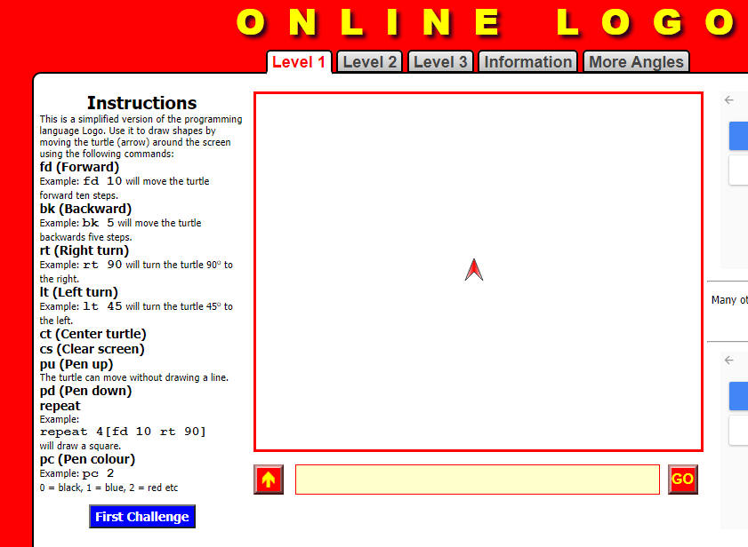

Slide 7
The importance of Debugging: Spotting the mistakes Sorting out the mistakes Make sure you have a space between the code

Slide 8
What other polygons can we program? Square (90) Triangle (120) Pentagon (72) hexagon (60) Octagon (45) Can you program these using the repeat command?
What do you think this code means?
Repeat 5 [FD 10 RT 72]
REPEAT 3 [FD 10 RT 120 ]
REPEAT 8 [FD 10 RT 45 ]

Slide 9
Is there any regular shape that can’t be made using an algorithm with 4 commands or less? What other shapes can you make?

