Slide 1
Geography

Slide 2
Skills
To locate continents, countries and oceans.
To use compass directions north, south east, west.

Slide 3
Knowledge
To locate the African Continent.
To locate 4 countries in Africa including Kenya.
To locate the seas and oceans around the African coast.

Slide 4
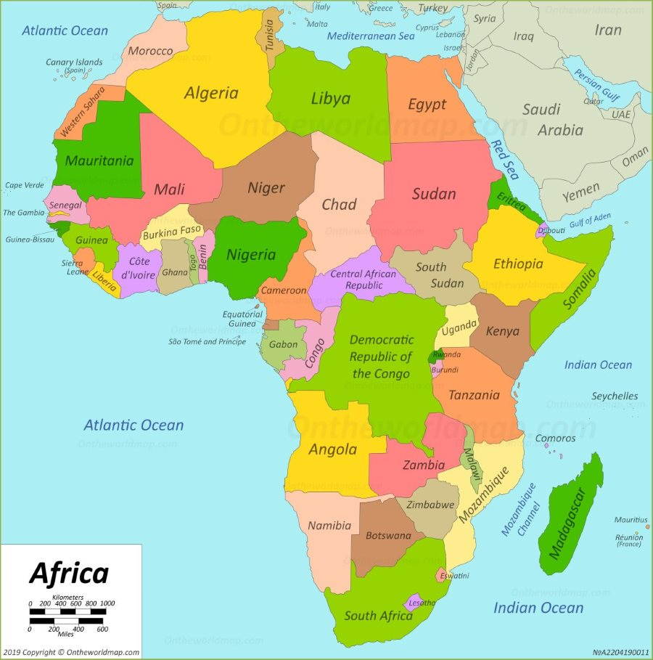
Monday 25th January
Ge: The African Continent

Slide 5
Previous Learning
Last week in Geography you leant about:
Continents and oceans.
Who can remember the name of any continents?
Who can remember the names of any oceans?

Slide 6
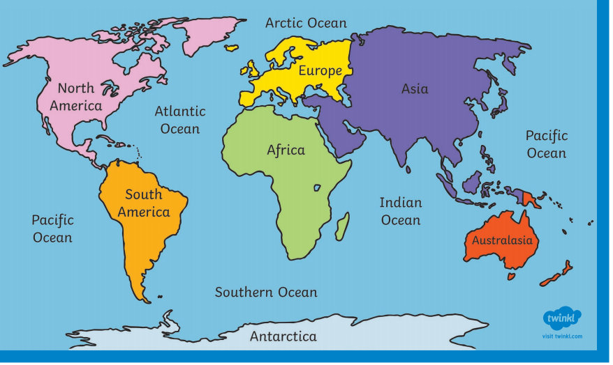

Slide 7
Key Vocabulary
Africa, continent, countries, world
map, oceans, surrounding, coast,
Kenya, locate, smallest, largest,
compass directions north, south east, west,

Slide 8
New Vocabulary
Coastline
Borders

Slide 9
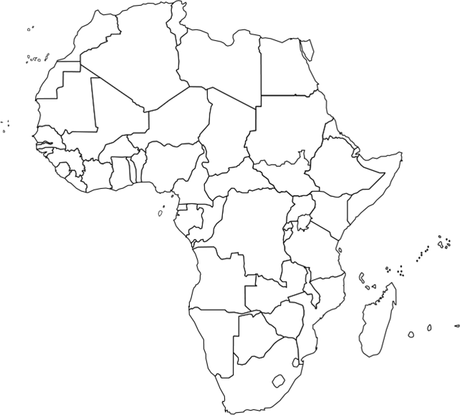
Borders
African coastline

Slide 10
Africa is made up of a lot of countries that form the second largest continent in the world.
Who can estimate how many countries make up the continent of Africa?
54 countries

Slide 11
Can you locate the smallest country
country in Africa?
Can you find the largest country in Africa?
Who can locate Kenya?

Slide 12
Algeria
The Gambia
Kenya

Slide 13
Independent Task
Answer the questions about the African Continent using the African map and the compass.

