Slide 5
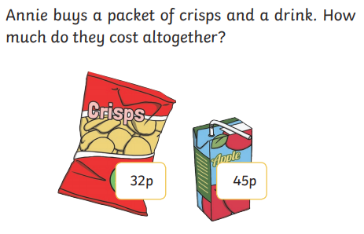
Annie has 95p in her purse. Do you think she has enough money to buy both items?
Why?

Slide 6
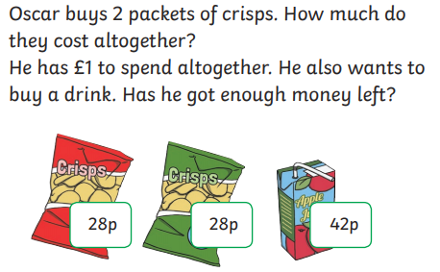
Oscar _______ have enough to buy the drink because…

