Slide 5
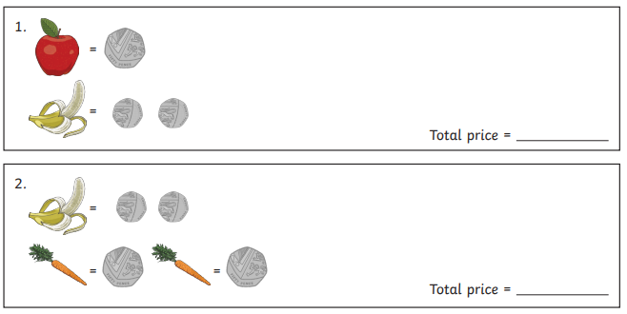
Find the total of the fruit and vegetables.

Slide 6
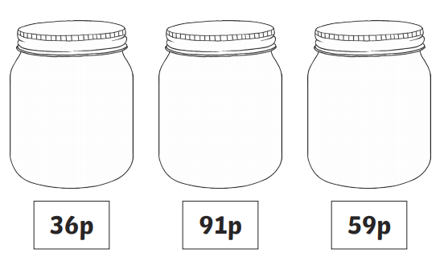
What coins could you use to make the total shown for each jar?

