Slide 1


Slide 3

1)
1 $+$1 $=$
1 $+$1 $+$1$+ \text{1}+\text{1}=$
2)
10 $+$ 10 $=$
10 $+$ 10 $+$ 10$+$ 10 $+$ 10 $=$
3)
5$+$ 5$=$
5 $+$ 5 $+$ 5 $=$

Slide 4
1)
1 $+$1 $=$
1 $+$1 $+$1$+ \text{1}+\text{1}=$
2)
10 $+$ 10 $=$
10 $+$ 10 $+$ 10$+$ 10 $+$ 10 $=$
3)
5$+$ 5$=$
5 $+$ 5 $+$ 5 $=$
2
5
20
50
10
15

Slide 6
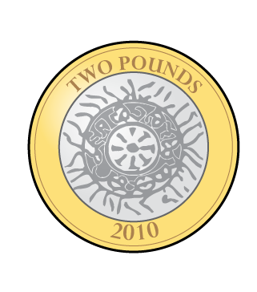
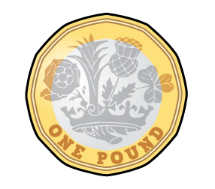
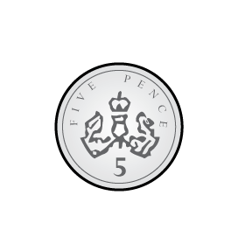
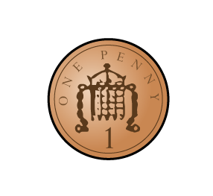
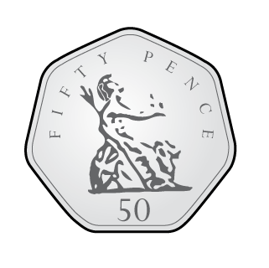
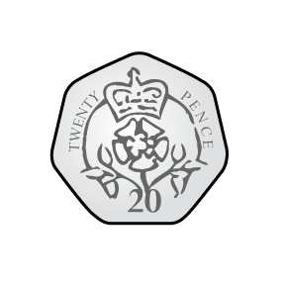
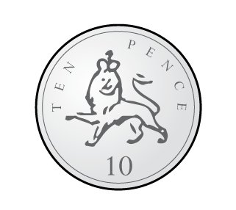

How can we sort these coins?
Value
Colour
Size
Shape
Words

Slide 7
10 ones is equal to 1 ten
We can exchange 10 ones for 1 ten
We can exchange 1 ten for 10 ones
2 pennies
5 pennies

Slide 8


Have a think
$$+$$
5 p
5 p
20 p

Slide 9
Smallest to greatest value

Slide 10




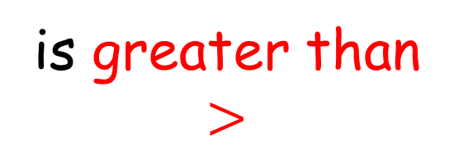

Let’s compare
Have a think
is greater than
$$>$$
is equal to
$$=$$
is less than
$$<$$
is greater than
$$>$$
is less than
$$<$$
is equal to
$$=$$

Slide 11
What is the same?
What is different?

Slide 12

is greater than
$$>$$

Slide 13
How many?
Have a think
There are 6 5p coins
There are 4 50p coins
There are 5 £1 coins
There are 3 £2 coins

Slide 14
Have a go at the first worksheet – Recognising Coins

Slide 15
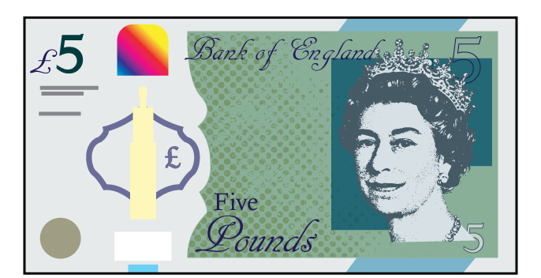
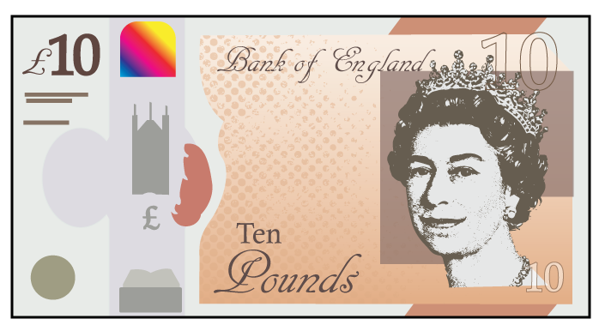
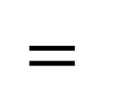
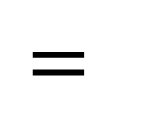
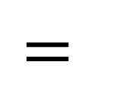
Recognising notes
$$=$$
Have a think
$$=$$
$$=$$

Slide 16
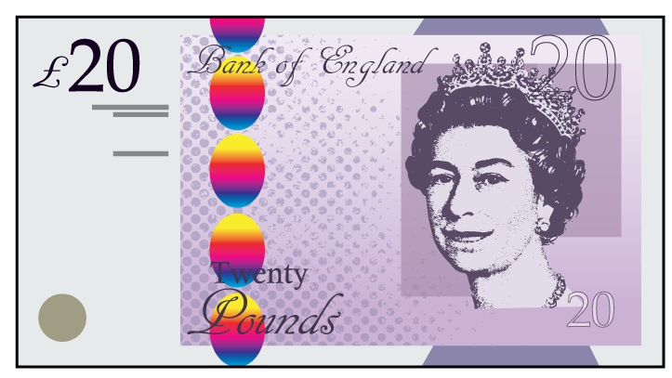
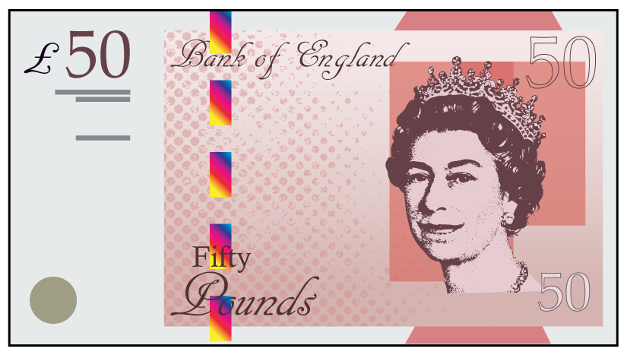
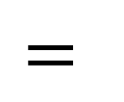
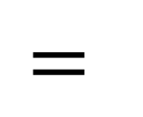
$$=$$
$$=$$

Slide 17
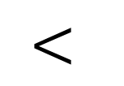
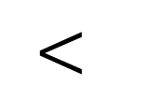
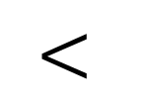
From least to greatest value.
$$<$$
$$<$$
$$<$$

Slide 18
How many?
Have a think
There are £5 notes
4
There are £10 notes
3
3
There are £20 notes
2
There are £50 notes

Slide 19
Have a go at the second worksheet – Recognising Notes

