Slide 1
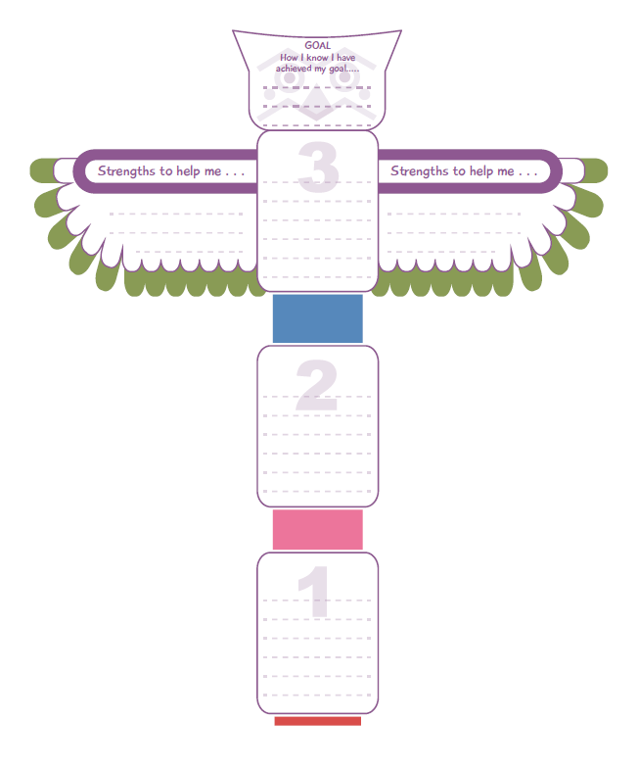
Place how you will know you have achieved your goal here. For example if your goal was to improve your handwriting, you might know it’s improved when you receive a certificate or produce consistently cursive handwriting in your book.
Think about the goal you have set yourself.
How can this be broken down into smaller steps?
What strengths and qualities will help you achieve this goal?
Think about the strengths or qualities needed to achieve your goal. For example perseverance, patience etc.
In the numbered boxes think about the smaller steps for success. For example if your goal is to improve your handwriting you will need to:
Buy a pen you like writing with
Practise handwriting particularly the letters you find trickier
Produce longer pieces of writing which demonstrate neat cursive handwriting.
You can either use this template in the portfolio section or draw your own version in your workbook.

