Slide 3
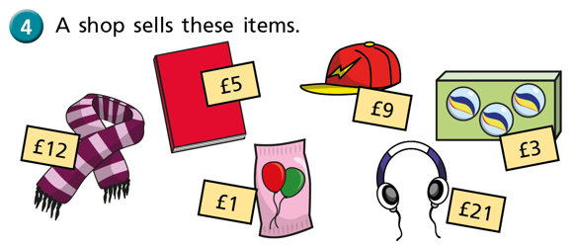

Slide 4
If all of the balls were reduced by £3, would your answers change?

