Slide 1
Figurative Language
What is it?

Slide 2
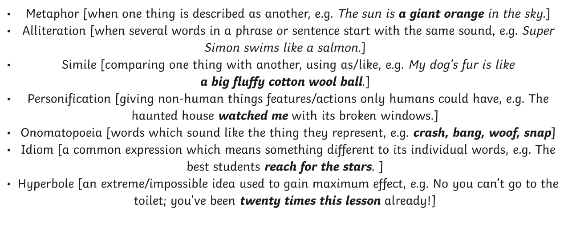
These are all examples of figurative language.

Slide 3
Take a look, and insert in the grid if you think the language is personification, an idiom, simile, metaphor, alliteration hyperbole or onomatopoeia. It might be easier to just write the number from each card.
Simile | Metaphor | Personification | Onomatopoeia | Alliteration | Idiom | Hyperbole

Slide 4
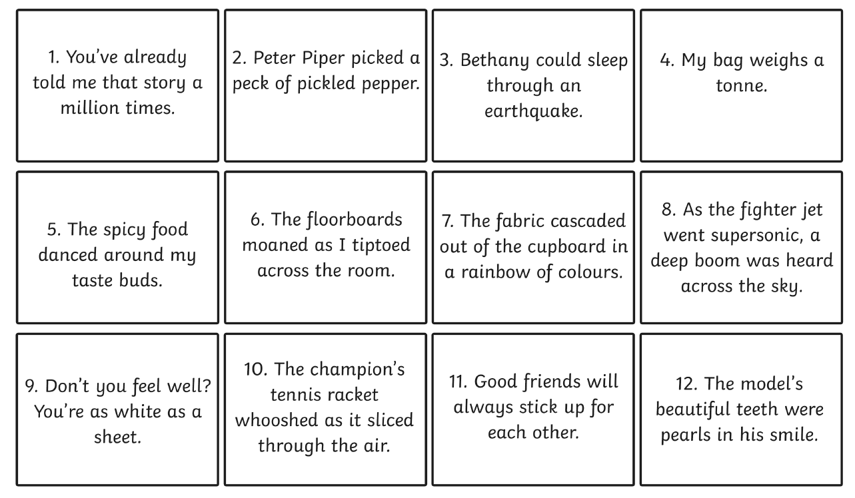

Slide 6
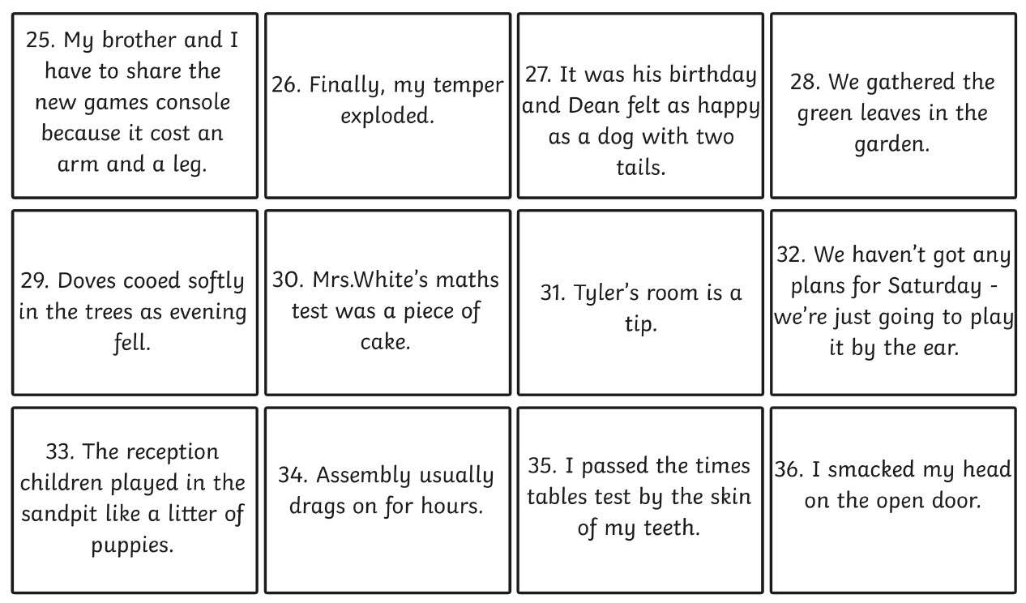

Slide 7
