Slide 1
Perseus and Medusa
Wednesday

Slide 2
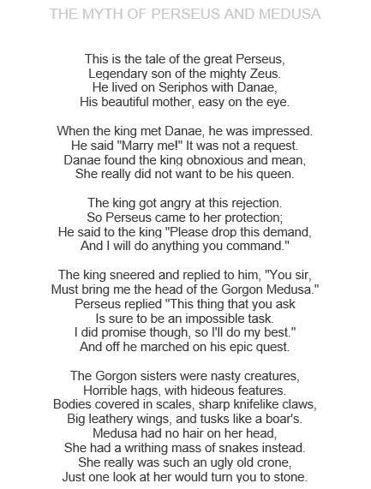

Slide 3
