Slide 2
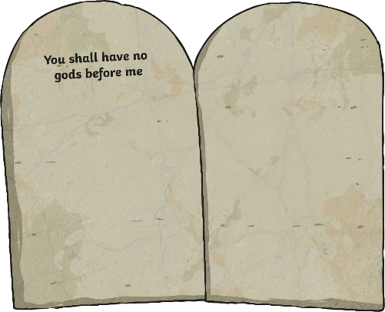
Commandment 1
You shall have no gods before me

Slide 3
Commandment 2
You shall not make any idols to worship

Slide 4
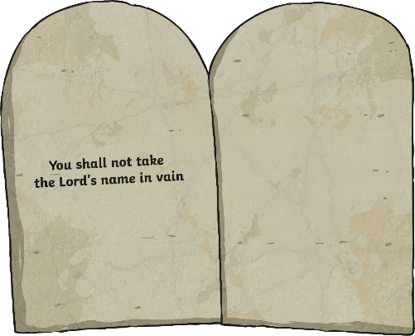
Commandment 3
You shall not take the Lord’s name in vain

Slide 5
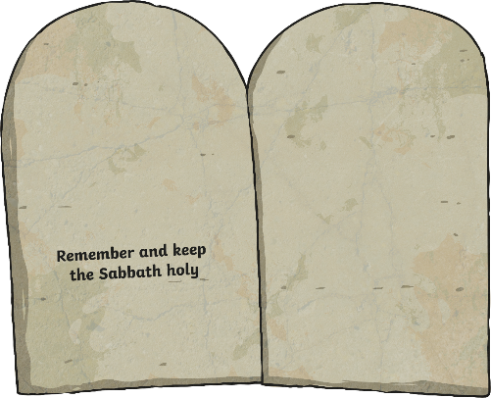
Commandment 4
Remember and keep the Sabbath holy

Slide 6
Commandment 5
Honour your father and mother

Slide 7
Commandment 6
You shall not kill

Slide 8
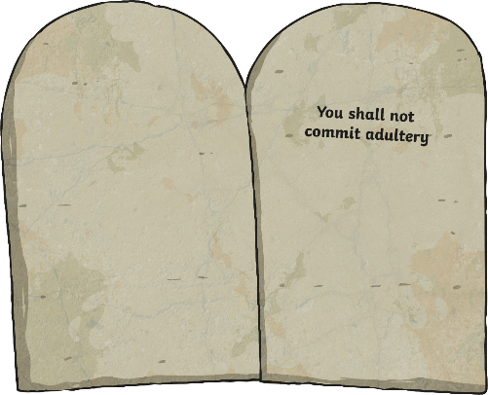
Commandment 7
You shall not commit adultery

Slide 9
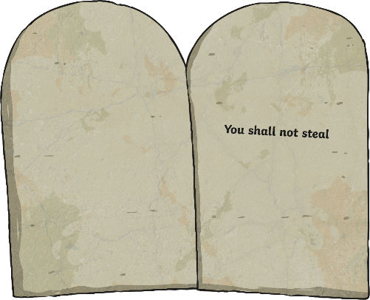
Commandment 8
You shall not steal

Slide 10
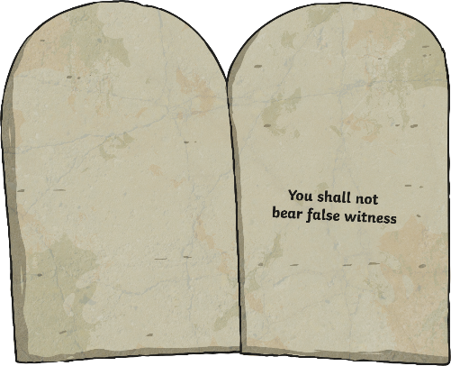
Commandment 9
You shall not bear false witness

Slide 11
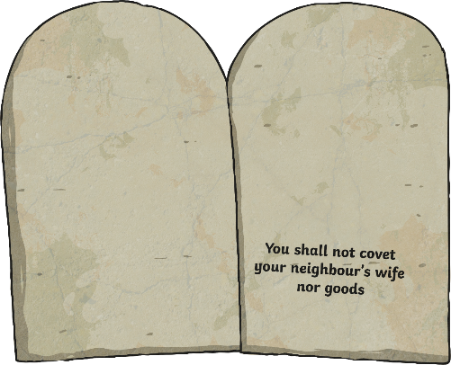
Commandment 10
You shall not covet your neighbour’s wife nor goods

