Slide 1
Animal Adaption
Science 2nd March 2021

Slide 2
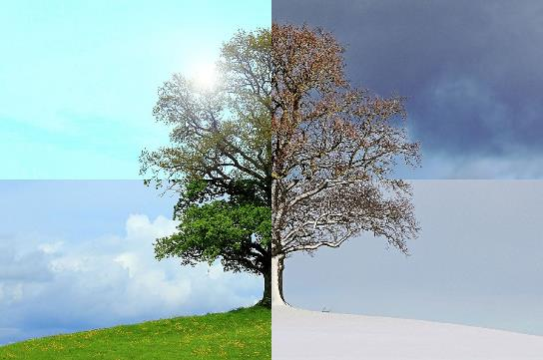
What Is Adaptation?
Adaptation is the process of change by which a species becomes better suited to its environment.

Slide 3
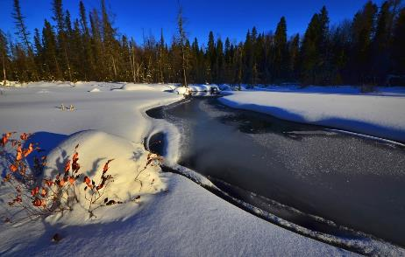
Why Must Animals Adapt?
Animals adapt when their natural habitat changes.
In Canada, winters can bring extreme changes in weather. In order to survive through the cold winters, animal species must adapt.

Slide 4
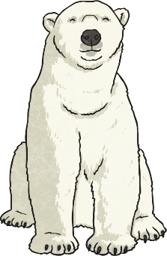
How Do Animals Adapt?
Each animal has certain features that helps it adapt to its environment. For example, the polar bear does not hibernate in winter like the grizzly bear does. Polar bears have features that help them adapt to the cold:
They have thick fur coats.
They have a layer of fat under their fur.
They have hair on their paws that helps them avoid slipping on the ice.

Slide 5
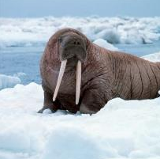
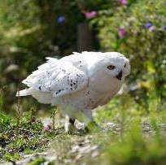
Adaptive Features
Can you think of other animals that have adaptive features?
Arctic Hare
Porcupine
Can you think of any?
Walrus
Snowy Owl

Slide 6
Arctic Hare
An Arctic hare has brown fur that turns white in the winter, so it is more difficult to find in the white snow.
Their hair grows longer and thicker in winter. They have strong claws to dig into the hard snow.

Slide 7
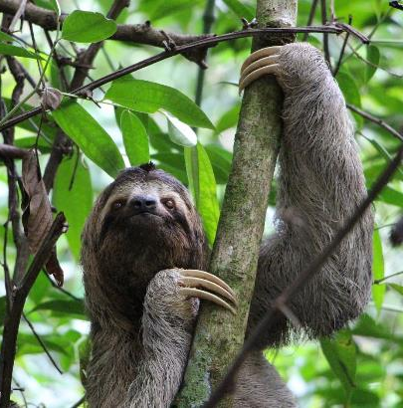
Sloth
Sloths are adapted to survive in tropical rainforests. They have very sharp claws which helps them to climb trees.
Sloths spend most of their lives in tree tops to avoid the predators living on the floor of the rainforest. Green algae grows on sloths fur which help to camouflage sloths from their predators.

Slide 8
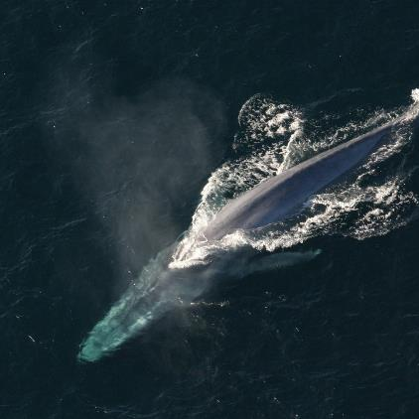
Whale
Whales are adapted to help them survive in the oceans. They are streamlined and can travel through water easily using their flippers.
Whales are warm-blooded mammals and have a thick layer of blubber under their skin to keep them warm. They have blow holes on top of their heads which let them breathe air in and out.

Slide 9
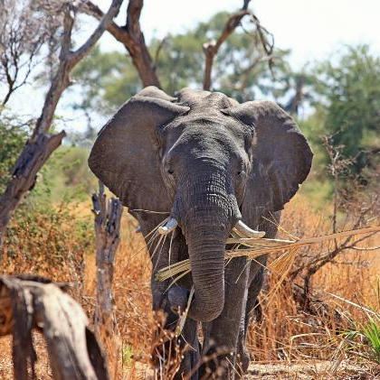
Elephant
Elephants eat plants and are adapted to survive in savannahs, forests and deserts. Their cushioned feet help them to walk silently which helps them avoid predators.
Elephants have very large ears to cool them down. They also have a long trunk which they use for many things including showering, making trumpeting sounds and picking things up.

Slide 10
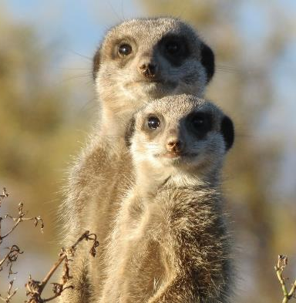
Meerkat
Meerkats are adapted to help them survive in deserts.
Meerkats have many predators. They have light coloured fur so that they are camouflaged. They have black patches around their eyes. This helps them to see predators more clearly in bright sunshine.
Meerkats live in groups. One or two meerkats will stand on their hind legs. They act as lookout for predators, whilst the other meerkats use their forefeet to help them find insects by digging the dirt.

Slide 11
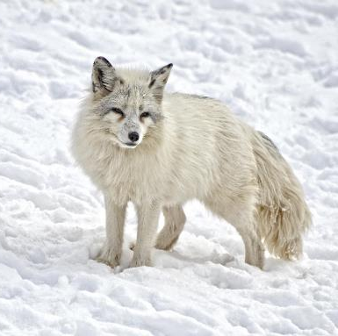
Arctic Fox
Arctic foxes are adapted to survive in cold places. They have white fur to help to camouflage them against the snow. This protects them from their predators and helps them to sneak up and catch lemmings and other small animals before they are seen.
Arctic foxes have many other adaptions to help them survive in the cold. They have small ears and noses to reduce heat loss. Their thick fur and thickly furred footpads help to keep them warm.

Slide 12
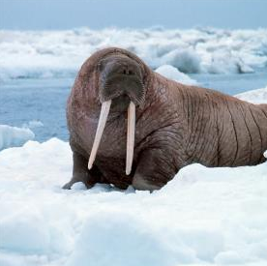
Walrus
A walrus is adapted to live in very cold places. The bottom of a walrus’ flippers are bumpy to help them grip onto the ice. A walrus’ tusks help them climb out of the water.
They have a thick layer of fat to protect them from getting too cold.

Slide 13
Porcupine
Porcupines are adapted to live in forests. They have sharp quills to help them if they are in trouble with another animal.
They are great tree climbers because they have thick pads under their paws.

Slide 14
Snowy Owl
Snowy owls are adapted to live in cold places. They have thick layers of feathers to keep them warm. They are white to help them camouflage in the winter. Their legs are also covered in feathers to keep them from getting cold.
Snowy owls are well adapted predators. They have large eyes to help them see their prey and asymmetric ears help them to hear their prey. Their silent feathers help them to sneak up silently on their prey and catch it!

Slide 15
Do Humans Adapt?
Humans have the ability to adapt to changes in their environment.
Think about what happens when you go swimming or take a bath. Does your body adapt to the water in any way?
Your fingers become wrinkled! Your body does this in order to help your fingers grip onto things, even in the water!
Yes

