Slide 1
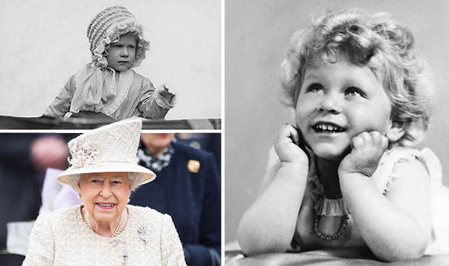
Tuesday 23rd February
History: The history of the Monarchy
Elizabeth was born on April 21, 1926. As a princess of the United Kingdom, Elizabeth lived a pampered life. She was educated by private tutors at home and enjoyed riding horses at her family's country home in Windsor Great Park.
Her younger sister, Princess Margaret, was born in 1930 and her family was close. However, Elizabeth was not a spoiled child. Many people commented on how mature Elizabeth was as a child.

Slide 2
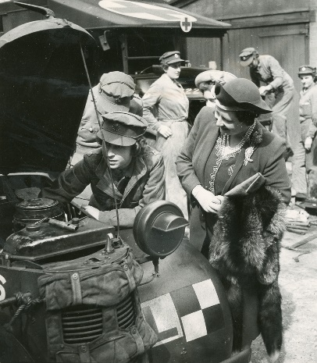
Tuesday 23rd February
History: The history of the Monarchy
When World War II began in 1939, it was suggested that the Queen, Elizabeth's mother, flee England and go to Canada. However, her mother refused to leave the king.
Elizabeth, along with her sister and mother, did leave the city of London, however. They spent much of the war at Windsor Castle. Elizabeth gave her first radio broadcast in 1940 on the BBC's Children's Hour. She also took an honorary position in the Auxiliary Territorial Service (the women's branch of the British Army) where she trained as a mechanic and driver.

Slide 3
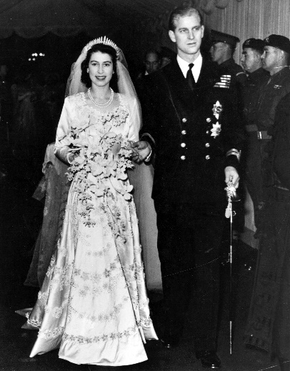
Tuesday 23rd February
History: The history of the Monarchy
Elizabeth was eight years old when she first met her future husband Prince Phillip of Greece and Denmark. She was only thirteen when she proclaimed she had fallen in love with him.
They announced their engagement in July of 1947 and were married in Westminster Abby on November 20, 1947.

Slide 4
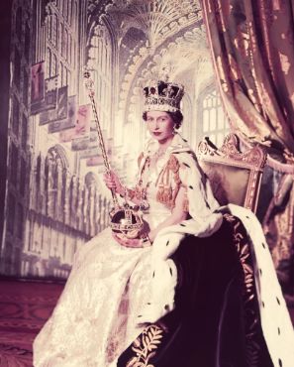
Tuesday 23rd February
History: The history of the Monarchy
In 1951, the King's health was poor. He could not go to many public events. Princess Elizabeth started to make official visits for him. The King died on 6 February 1952. Elizabeth was crowned queen on 2 June 1953. The ceremony was held in Westminster Abbey.

Slide 5
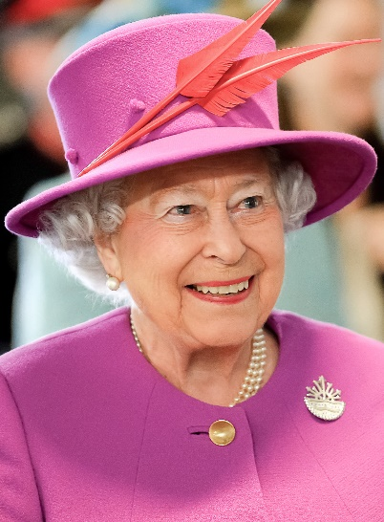
Tuesday 23rd February
History: The history of the Monarchy
Queen Elizabeth II became the longest-reigning British monarch on 9 September 2015 when she surpassed the reign of her great-great-grandmother Victoria.
On 6 February 2017 she became the first British monarch to celebrate a Sapphire Jubilee, commemorating 65 years on the throne.

