Slide 1
Monday 8th March
GPS: Verbs
With a partner, discuss…
What is a verb?

Slide 2
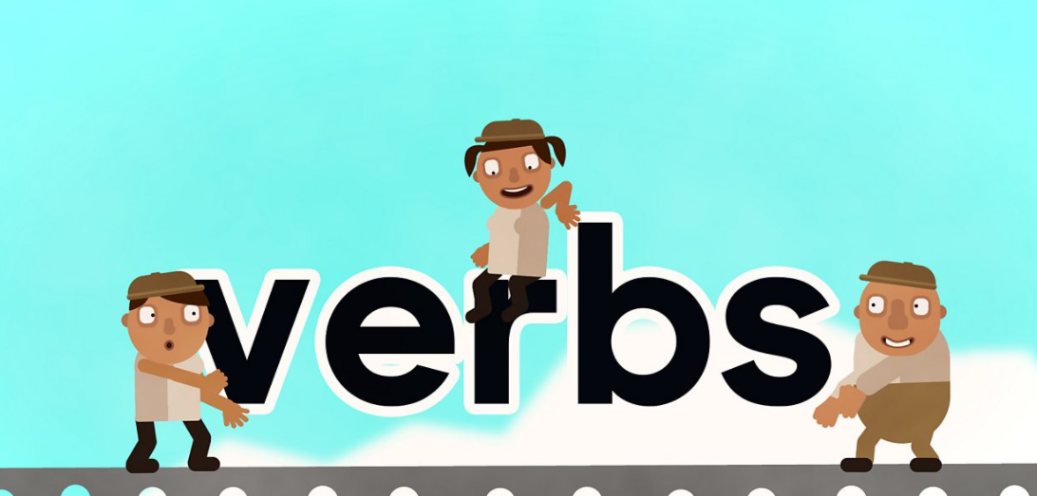
Monday 8th March
Watch:
https://www.bbc.co.uk/bitesize/topics/zrqqtfr/articles/zpxhdxs

Slide 3
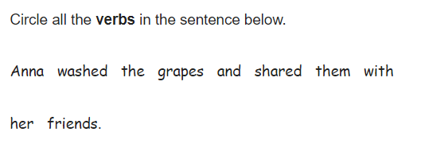
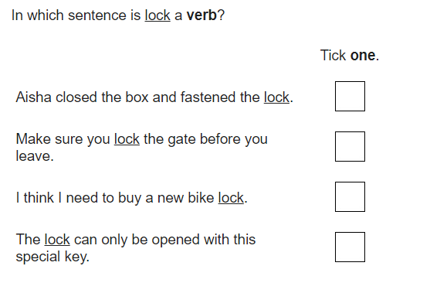
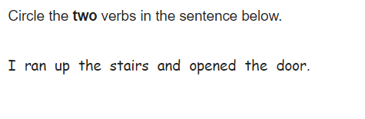
In books
A verb is a word used to describe an action, state or occurrence.

Slide 4
A verb is a word used to describe an action, state or occurrence.
Are the following an action, state or an occurrence?
The rabbit was jumping in the field.
The monster likes rollercoasters.
The caterpillar became a butterfly.

Slide 5
Tuesday 9th March
23. Retrieval
Read pages XXXVI – XXXVII and decide whether the statements below are true or false:
True or false?
Julius does not know what ‘in a pickle’ means.
Julius does not recognise the lion’s voice.
We know the Romans have captured the animals.
The people who have captured the animals have wolves with them.
The people who have captured the animals do not want the animals alive.

Slide 6
Teacher: Read pages XXXVIII -XLIII

Slide 7
Tuesday 9th March
23. Retrieval
Task 2
Can you write your own true or false statements for pages XLII-XLIII?

Slide 8
Wednesday 10th March
4. Inference
Read pages XLIV – LII
How does each animal feel about being captured?

Slide 9
Character | How do they feel? | Evidence from the text to suggest this:
The Lion
Julius (The zebra)
Cornelius (The warthog)

Slide 10
Plenary
Teacher - read to chapter 6.

Slide 11
Thursday 11th March
NFER

Slide 12
Friday 12th March
NFER

