Slide 1
Monday 8th March
16. Apostrophes
Plural, contraction or possession?
Don’t look at the sun directly.
The Romans lived a long time ago.
The man furiously rolled up his scroll as he stared into his brother’s eyes.

Slide 2
Monday 8th March
16. Apostrophes
Plural, contraction or possession?
Don’t look at the sun directly.
The Romans lived a long time ago.
The man furiously rolled up his scroll as he stared into his brother’s eyes.

Slide 3
25. Non-Chronological Reports
This week, we are going to write a non-chronological report on Romans.
Here are some features of a non-chronological report:

Slide 4
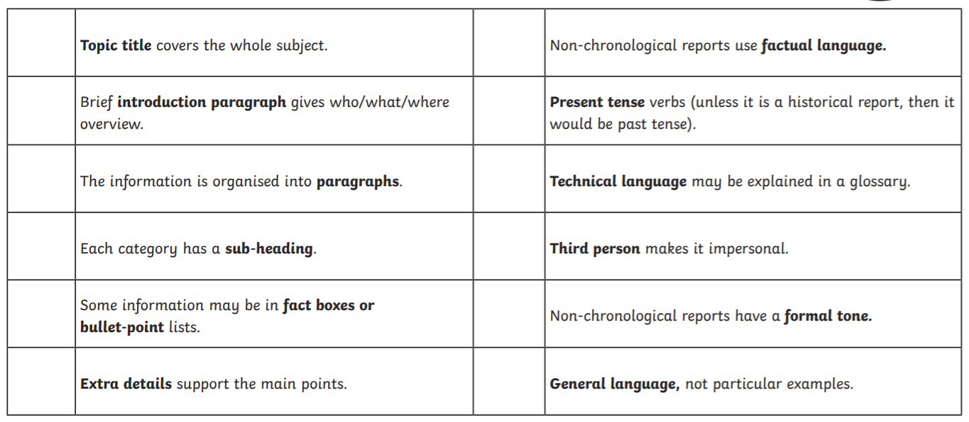

Slide 5
Task one
Lets read through the non-chronological report.
Can you identify the following features in the report?
Heading
Subheading
Fact boxes
Bullet points
Factual language
Captions
Images/photographs

Slide 6
Task two
A key feature of a non-chronological report is factual language.
Can you identify which sentences use factual language?
The Roman gladiator pulled out his sword heroically.
Usually, the Romans would eat three meals per day.
Women also fought as gladiators.
An orange sky served as a backdrop behind the ancient city of Rome.
Romans rarely fought against animals.
The lion lunged at the gladiator, his razor sharp teeth just missing the gladiator’s arm.

Slide 7
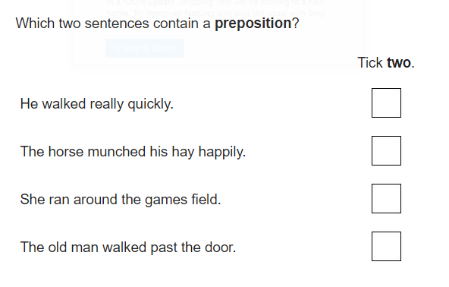
Tuesday 9th March
12. Prepositions

Slide 8
Collecting Facts
We going to collect facts for our non-chronological report on Romans.
We need to collect facts about the following areas:
What did the Romans do to relax?
https://www.bbc.co.uk/bitesize/clips/zv8w2hv
https://www.bbc.co.uk/bitesize/clips/zdrc87h
Life as a Roman Soldier
https://www.bbc.co.uk/bitesize/clips/zgsfb9q
https://www.bbc.co.uk/bitesize/clips/zsmxpv4
What did the Romans do for us?
https://www.bbc.co.uk/bitesize/clips/z8d6nbk
https://www.bbc.co.uk/bitesize/clips/z6vb4wx

Slide 9
Collecting Facts
Using the laptops, can you add to the facts you have collected?
Remember to use child friendly search engines:
https://www.kiddle.co/
https://swiggle.org.uk/
https://www.alarms.org/kidrex/

Slide 10
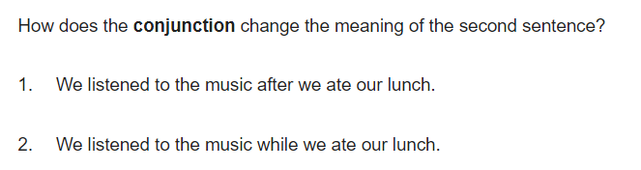
Wednesday 10th March
12. Conjunctions

Slide 11
24. Planning
We are going to plan our non-chronological report today. Make sure you have all the facts that you collected from yesterday in front of you.

Slide 12
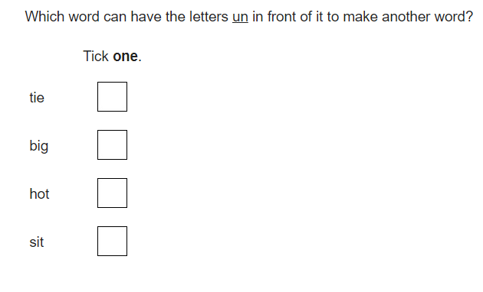
Thursday 11th March
12. Prefixes

Slide 13
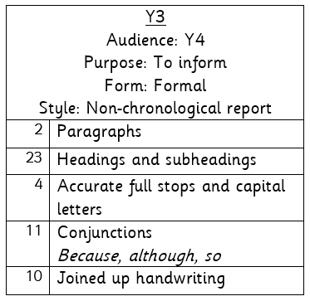

Slide 14
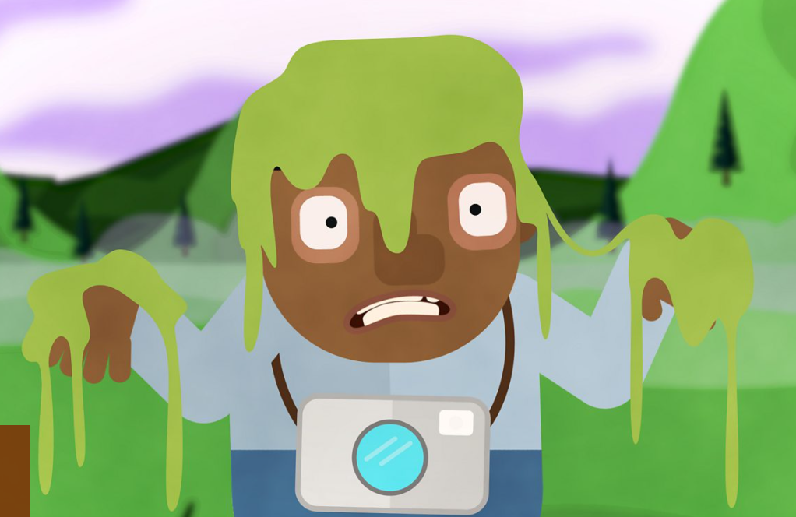
Friday 12th March
Continued
https://www.bbc.co.uk/bitesize/topics/zwwp8mn/articles/zsrt4qt

