Slide 1
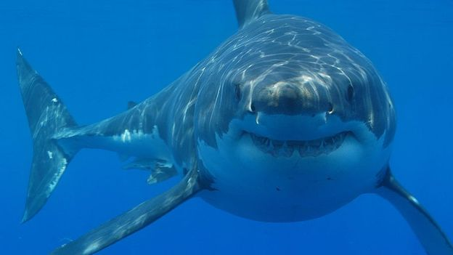
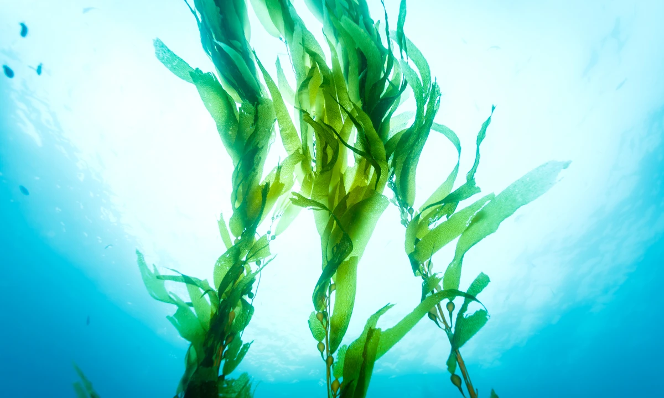
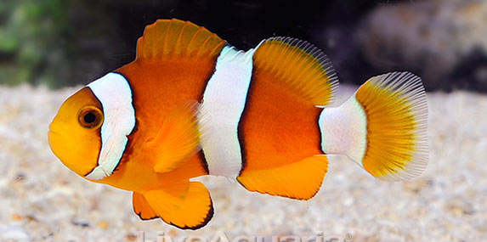
Task
Can you unscramble the following food chain?
Prey
Predator
Producer

Slide 2
Discuss
Spot what is missing
What would happen if sharks became extinct?
Prey
Producer
Predator
Extinction is the dying out or disappearance of a species from earth.

Slide 3
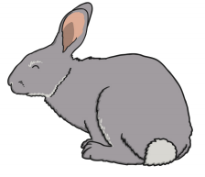
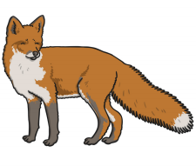
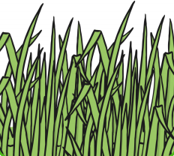
Task – in books
Key vocabulary:
Producer
Prey
Predator
Sort the following food chain and label each element correctly
Remember, what way do the arrows point?

Slide 4
How would the following scenario effect your food chain?
Foxes become extinct.
Write your answer underneath your food chain in your books.

Slide 5
How would the following scenario effect your food chain?
Houses are built on the meadow, which is the rabbit’s habitat.
Write your answer underneath your food chain in your books.

