Slide 2
What do you think needs to be included in a postcard?
Space for a picture (on the front)
Blank lines for an address.
Space to write about your holiday.
postcard
The name and address of who you’re sending it to.
Some writing to say what you’ve been doing on your holiday.
Space in the top right corner for a stamp.

Slide 3
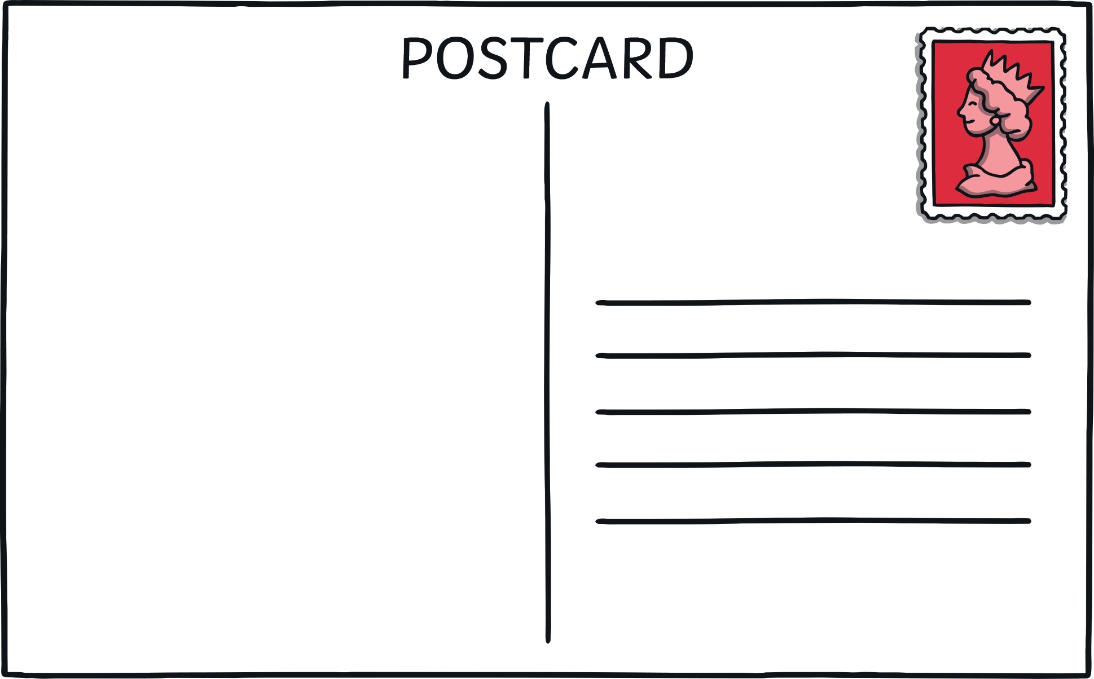

Slide 4

What might you write about in a postcard?
Maybe what you have done so far and what you are going to do?
Yesterday we went to the beach. Tomorrow we will go on a boat trip.

Slide 5
A stamp in the top right corner.
Dear Tom,
We are having lots of fun on holiday. Yesterday, we went to the beach. I made a huge sandcastle and ate lots of ice cream.
Today we went to a theme park. We went on lots of scary rides but it was lots of fun!
Tomorrow we are going to go on a boat trip. I hope we see dolphins!
From Anna x
Lines for writing the address.
Tom Hill
123 High Street
Clifftop Town
HT13 4TW
Space to write about your holiday – what you have done and what you will be doing.
The name and address for who you are sending the postcard to.

Slide 6
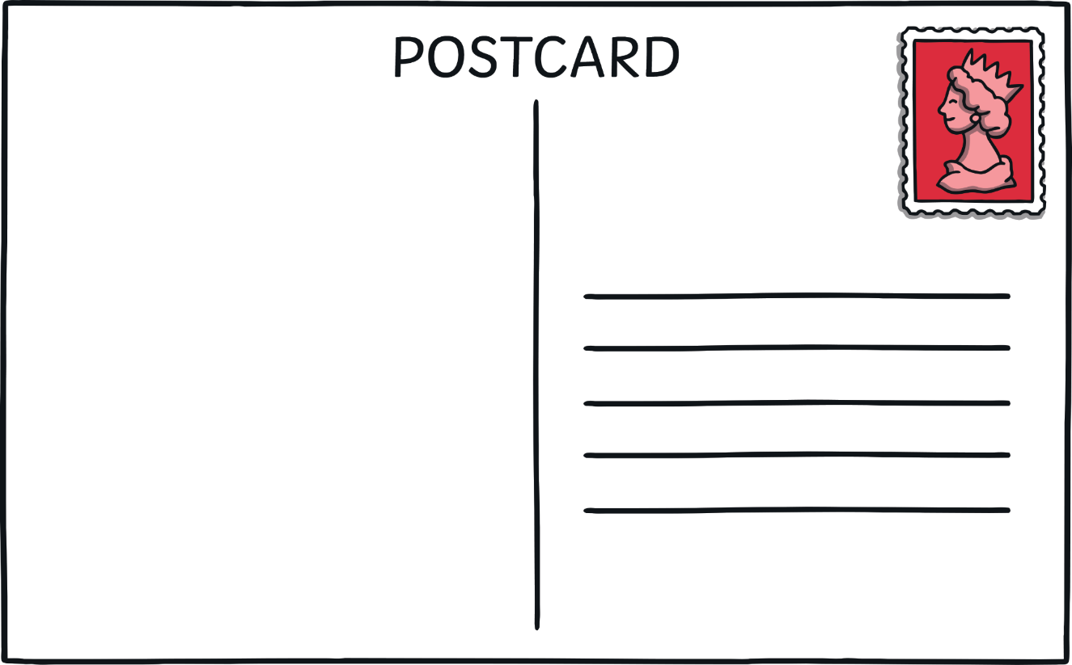

A picture on the front of your postcard showing where you are on holiday.
Dear Tom,
We are having lots of fun on holiday. Yesterday, we went to the beach. I made a huge sandcastle and ate lots of ice cream.
Today we went to a theme park. We went on lots of scary rides but it was lots of fun!
Tomorrow we are going to go on a boat trip. I hope we see dolphins!
From Anna x
Tom Hill
123 High Street
Clifftop Town
HT13 4TW

Slide 7

Plenary
What are the six things that need to go on a postcard?
Give two suggestions of what you might write about in a post card.

